Slide 1
ECSC 325.200
Web Server Administration
Spring 2025 – Week 6-1 – February 18th, 2025
Server configs and Virtual Hosts
Prof. Jason Patalon

Slide 2

Objectives
Attendance and administrative
Semester Grades Review
SSH Proxy Connection Review
PHP Installation
MariaDB Installation
Test website configurations
Virtual hosts
  Ecsc325-1##, phpMyAdmin,
  temperature graphs, Megastuff,
  Ultrastuff, Wordpress…

Slide 3

Weekly Info
A dream written down with a date becomes a goal. A goal broken down into steps becomes a plan. A plan backed by action makes your dreams come true. – Greg S. Reid
Attendance
Good of the class
Assignment 5 due tomorrow Feb 19th!
Assignments 6 & 7 due Feb 26th!
Midterm next week – Feb 27th!
Final – Tuesday April 29th!

Slide 4


Recap and Review
The next few weeks…
  Web servers & forms
  Database services
  E-mail services
  File transfer services
  Security and authentication
  Monitoring and performance tuning
Corrections, updates, etc.
Review of previous assignments
  Assignment reviews…
Questions from previous classes?
Etcetera
Clouds?!

Slide 5

Web Browser SOCKS Proxy Config
Firefox Example
  Extremely easy to set, others more difficult
Open SSH tunnel with dynamic port forwarding to jpatalon.cs.edinboro.edu:54321
  Ex: ssh –D 55555 cs_student@jpatalon.cs.edinboro.edu –p 54321
    Connect on port 54321 (-p)
    SOCKS Dynamic Proxy on port 55555 (-D)
    Password info in credentials file in D2L!
Launch Firefox!
  Configure the proxy settings in Firefox…

Slide 6
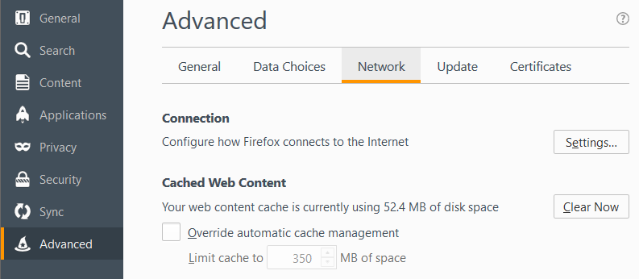
Web Browser SOCKS Proxy Config
Exact steps may differ depending on version
  Options
  Advanced
  Network Tab
  Settings…
Older Firefox
version…

Slide 7
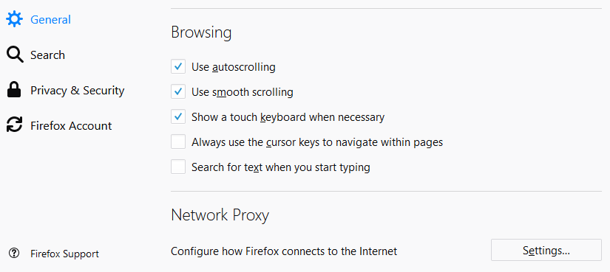
Web Browser SOCKS Proxy Config
Exact steps may differ depending on version
  Options
  General
  Network Proxy
    All the way at the bottom
  Settings…
Firefox
v59.0.1+

Slide 8
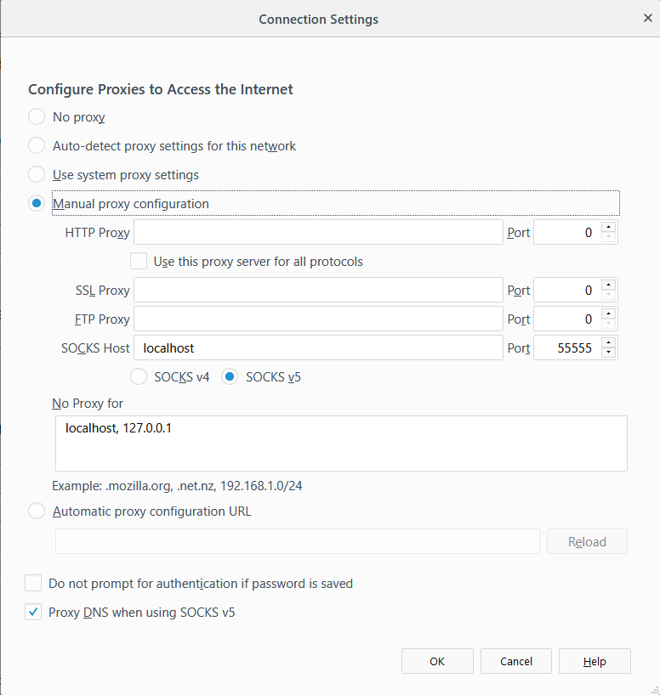
Web Browser SOCKS Proxy Config
Exact steps may differ depending on version…
  Options
  Advanced
  Network Tab
  Settings…
    Manual Proxy Configuration
    SOCKS Host: localhost
    Port: 55555
    SOCKS v5
    No proxy for:
      localhost, 127.0.0.1
    Proxy DNS when using SOCKS v5

Slide 9
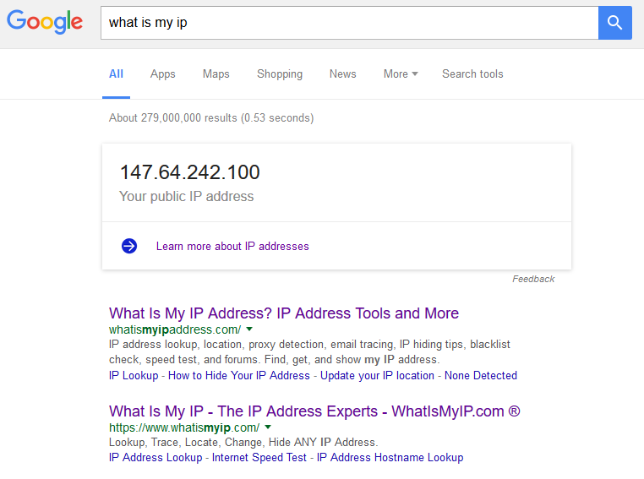
Web Browser SOCKS Proxy Config
Test by opening a web page, and visit a website that will tell you your IP
  http://whatismyip.com
  Type in to google “What is my ip”
  Multiple servers with multiple ports
    Open multiple connections on different ports
    Switch ports to quickly switch proxy endpoint
  Compare to same search in a different browser
  that is not configured for proxying
    Firefox should give a different result than Chrome or
    Interner Explorer, since Firefox is configured to
    use the SSH SOCKS proxy and the other web
    browsers are not.
  EUP outbound traffic is NAT’d, so you might
  not see a different IP address anymore!

Slide 10

Server Configuration
Install PHP
  dnf install php
  New php-fpm service is installed!
  Main PHP configuration file located at /etc/php.ini
  PHP adds a configuration file to Apache
    /etc/httpd/conf.modules.d/10-php.conf
  Apache needs restarted to pick up new config file!
    systemctl restart httpd.service
  Create a new document /var/www/html/index.php
    <?php
    phpinfo();
    ?>
  Open new php web page:
    VM’s: http://ecsc325-1##.cs.edinboro.edu/index.php
php-fpm
service!

Slide 11
Server Configuration
Change Default Index Page
  Edit apache configuration file /etc/httpd/conf/httpd.conf
  Find the DirectoryIndex setting, change to below:
    DirectoryIndex index.php index.html
  Apache needs restarted (again) to pick up changed config file
    systemctl restart httpd.service
Disable phpinfo?!
  Edit /etc/php.ini file, add phpinfo to disable_functions
    disable_functions = phpinfo
  Restart php-fpm service
    systemctl restart php-fpm
  Refresh Website
  Re-enable, restart php-fpm, and refresh page again
    Phpinfo can be considered a security risk, but we want it enabled for now!

Slide 12
Server Configuration
MariaDB – A fork of MySQL, intended as a drop in replacement
Install MariaDB
  dnf install mariadb-server
Start and enable MariaDB
  systemctl start mariadb.service
  systemctl enable mariadb.service
Secure the MariaDB Service
  mysql_secure_installation
    Set root password, remove anonymous users, disallow root remote login,
    remove test database, reload privileges.
Log in to MariaDB
  mysql –u root –p
    help;
    exit;

Slide 13
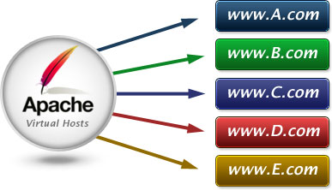
Virtual Host Configurations
Virtual hosts have been created for each student
31## Virtual hosts use a CNAME DNS records to point to student’s records
  3125.megastuff.biz canonical name = ecsc325-125.cs.edinboro.edu.
1## Virtual hosts use A record to IP address
  Name: 125.megastuff.biz
  Address: 147.64.243.125
VM’s: http://1##.megastuff.biz and http://31##.megastuff.biz
    NUMBER is 01-25 (ex: 101-125 and 3101-3125)
    Ex: http://125.megastuff.biz and http://3125.megastuff.biz
    points to http://ecsc325-125.cs.edinboro.edu
  Make note of your virtual hosts!
  Remember, direct VM connections only work on CS network!
    Must connect through VPN!

Slide 14
Virtual Host Configurations
Before creating virtual hosts, we need to explicitly
set our default host!
  Create the file /etc/httpd/conf.d/00-localhost.conf
    <VirtualHost *:80>
    ServerName ecsc325-1##.cs.edinboro.edu
    ServerAlias 147.64.243.1##
    DocumentRoot "/var/www/html"
    </VirtualHost>
  This will ensure that traffic to the default hostname or
  server IP go to the default location
  Restart apache to apply new configuration file
    We shouldn’t notice anything different on our website yet…
    http://ecsc325-1##.cs.edinboro.edu
Replace the ## with your 2-digit number!

Slide 15
Virtual Host Configurations
Create the http://31##.megastuff.biz virtual host
  Create the file /etc/httpd/conf.d/31##.conf
    <VirtualHost *:80>
    ServerName 31##.megastuff.biz
    DocumentRoot "/var/www/31##"
    </VirtualHost>
  Create the 31## folder mentioned above!
    mkdir /var/www/31##
  Create an index page in for the new virtual host!
    echo Hello Megastuff > /var/www/31##/index.html
  Restart Apache and check if it worked!
    Visit http://31##.megastuff.biz
  Validate our old site still works – should display phpinfo!
    Visit: http://ecsc325-1##.cs.edinboro.edu
    Visit: http://147.64.243.1##
Replace the ## with your 2-digit number!

Slide 16
Virtual Host Configurations
Create the http://31##.megastuff.biz:81 virtual host
  Create the file /etc/httpd/conf.d/31##p81.conf
    <VirtualHost *:81>
    ServerName 31##.megastuff.biz
    DocumentRoot "/var/www/31##p81"
    </VirtualHost>
  Create the 31## folder mentioned above!
    mkdir /var/www/31##p81
  Create an index page in for the new virtual host!
    echo Hey there port 81 > /var/www/31##p81/index.html
  Have to add a statement to allow listening on port 81!
    Details on the next slide! Yay!
    Don’t forget to restart apache after changing .conf files!
      systemctl restart httpd
Replace the ## with your 2-digit number!

Slide 17

Virtual Host Configurations
Create the http://31##.megastuff.biz:81 virtual host
  We have to also edit our main httpd.conf file to listen on port 81!
    Edit the file /etc/httpd/conf/httpd.conf and add this line
    below the “Listen 80” line:
      Listen 81
      It should look like this when done:
  Restart Apache and check if it worked!
    Visit http://31##.megastuff.biz:81
  Validate our old sites still work – should still display phpinfo!
    Visit: http://ecsc325-1##.cs.edinboro.edu
    Visit: http://147.64.243.1##
Replace the ## with your 2-digit number!

Slide 18

Virtual Host Configurations
Create new Ultra Modern webpage from template on virtual host
  Install unzip package to provide unzip functionality!
      dnf provides *bin/unzip
      dnf -y install unzip
  Download template and move to www directory
      mkdir -p /tmp/ultra_template
      cd /tmp/ultra_template
      wget https://jpatalon.cs.edinboro.edu/ecsc325/classfiles/ultra_modern.zip
      unzip -e ultra_modern.zip
      ls
      mv web/ /var/www/
      cd /var/www/web
      pwd
      ls -lah /var/www/
Notes:
Ultra Modern Template Website

Slide 19
Virtual Host Configurations
Create new webpage from template on virtual host
  Create new virtual host config file at /etc/httpd/conf.d/web.conf
      <VirtualHost *:80>
      DocumentRoot "/var/www/web"
      # Note server name below is 3 digits
      ServerName 1##.ultrastuff.net
      </VirtualHost>
  Test that it all worked!
    Restart apache
      systemctl restart httpd.service
    Visit websites and verify
        http://1##.ultrastuff.net
Notes:
Ultra Modern Template Website

Slide 20

Virtual Host Configurations
Create new WordPress site on virtual host
  Install Prerequisites
      dnf -y install php-mysqlnd
      systemctl restart httpd.service
  Create Database and User
      mysql -u root –p
        Log in with your root mysql password!
      create database wordpressdb;
      grant all privileges ON wordpressdb.* TO "wordpressuser"@"localhost" identified by "wordpresspass";
      flush privileges;
      show databases;
      select user,host,password from mysql.user;
      exit;
Notes:
WordPress Website

Slide 21
Virtual Host Configurations
Create new WordPress site on virtual host
  Install tar!
    dnf -y install tar
  Download package
      cd /tmp
      wget https://wordpress.org/latest.tar.gz -O /tmp/latest.tar.gz
      tar zxvf /tmp/latest.tar.gz
      ls
      mv /tmp/wordpress/ /var/www/
  Check the permissions! We should secure our wordpress directory!
      ls -lah /var/www
      chown -R root:apache /var/www/wordpress
      chmod -R ug+rwX,o-rwx /var/www/wordpress
      ls -lah /var/www
      ls -lah /var/www/wordpress
Notes:
WordPress Website

Slide 22
Virtual Host Configurations
Create new WordPress site on virtual host
  Create new virtual host config file at /etc/httpd/conf.d/wordpress.conf
      <VirtualHost *:80>
      DocumentRoot "/var/www/wordpress"
      # Note server name below is 4 digits
      ServerName 31##.ultrastuff.net
      </VirtualHost>
  Test that it all worked!
    Restart apache
        systemctl restart httpd.service
    Visit websites and verify
      http://31##.ultrastuff.net
      Should get WordPress config page!
        Not working? Something else wrong? Check the logs!
            /var/log/httpd/
Notes:
WordPress Website

Slide 23
Update PHP!
Our PHP Installation is pretty old…
  This is typical of RedHat based distros
  They standardize on a specific version (ex: 5.4)
  They “back-port” fixes, features, and other updates as they see necessary
    Sometimes this means the default version of a package is older that what we need!
RedHat and CentOS have a selection of additional software repositories
  Let’s install two additional software repositories, enable the remi-php56 repo, and update!
      dnf -y install https://dl.fedoraproject.org/pub/epel/epel-release-latest-7.noarch.rpm
      dnf -y install http://rpms.remirepo.net/enterprise/remi-release-7.rpm
      dnf -y install dnf-utils
      dnf-config-manager --enable remi-php56
      dnf -y update
  Restart Apache!
      systemctl restart httpd
Only for
RHEL7/CentOS7!

Slide 24
Virtual Host Configurations
Create new WordPress site on virtual host
  Configure WordPress Database
    Database Name: wordpressdb
    Username: wordpressuser
    Password: wordpresspass
    Database Host: localhost
    Prefix: wp_
  Configure WordPress Website
    Site Title: Your Name
    Username: Your wordpress user
    Password: Your wordpress password
    Email: Your university email
    Discourage search engines from indexing site
      Doesn’t really matter, search engines can’t access our sites anyways!
Notes:
WordPress Website

Slide 25
Virtual Host Configurations
Replace the ## with your 2 digit number!!!
Create new WordPress site on virtual host
  Allow for updates without FTP
    Edit file: /var/www/wordpress/wp-config.php
    Add to end of file:
        define('FS_METHOD','direct');
    Restart apache
      systemctl restart httpd.service
  Update or Reinstall WordPress!
    Proceed to login page
      http://31##.ultrastuff.biz/wp-login.php
    Check for updates
      Update yo site!
        Re-install if there are no updates!
          This makes sure the process will work!
Notes:
WordPress Website

Slide 26
Virtual Host Configurations
Install phpMyAdmin
  Install Prerequisites
    A new dnf repository has appeared! Extra Packages for Enterprise Linux
      Provides additional packages that are not maintained by official OS channels
      dnf config-manager --set-enabled crb
      dnf -y install https://dl.fedoraproject.org/pub/epel/epel{,-next}-release-latest-9.noarch.rpm
      dnf -y install phpmyadmin
  Edit /etc/httpd/conf.d/phpMyAdmin.conf
    By default, phpMyAdmin only allows access from the localhost
      This is a security feature; we really should proxy our web connection…
    Change the 2 lines that say "Require local" to below:
    Require ip 127.0.0.1 0.0.0.0/0.0.0.0 # 2 of these lines
  Restart Apache!
    systemctl restart httpd.service
Optionally allow from
147.64.0.0/255.255.0.0
Notes:
phpMyAdmin Website

Slide 27
Virtual Host Configurations
Replace the ## with your 2 digit number!!!
Install phpMyAdmin
  Visit website:
    http://1##.ultrastuff.net/phpmyadmin
    http://1##.megastuff.biz/phpmyadmin
    http://31##.megastuff.biz/phpmyadmin
    http://ecsc325-1##.cs.edinboro.edu/phpmyadmin
    http://147.64.243.1##/phpmyadmin
  Notice you can get to phpMyAdmin from any domain!
    This is not really desired behavior…
    We’re going to change this in a minute…
  Use your MariaDB user credentials to log in!
    Just like logging in to mysql from the command line.
Notes:
phpMyAdmin Website

Slide 28
Virtual Host Configurations
Install phpMyAdmin
  Edit /etc/httpd/conf.d/phpMyAdmin.conf
    Add to beginning of file (immediately before first line starting with Alias):
        <VirtualHost *:80>
        DocumentRoot "/var/www/html"
        ServerName ecsc325-1##.cs.edinboro.edu
        ServerAlias ecsc325-1##
        ServerAlias 147.64.243.1##
        ServerAlias localhost
        ServerAlias 127.0.0.1
        ServerAlias ::1
    Add to the end of file:
        </VirtualHost>
This forces everything in phpMyAdmin.conf to only be available within the ecsc325-1## FQDN, IP, or localhost addresses!
Notes:
phpMyAdmin Website

Slide 29
Virtual Host Configurations
Install phpMyAdmin
  Delete old localhost virtualhost configuration file:
    rm -rf /etc/httpd/conf.d/00-localhost.conf
  Restart Apache@!
    systemctl restart httpd.service
  Visit website:
  VM's:
    http://1##.ultrastuff.net/phpmyadmin
    http://1##.megastuff.biz/phpmyadmin
    http://31##.megastuff.biz/phpmyadmin
    The three above should no longer work, the two below should!
    http://ecsc325-1##.cs.edinboro.edu/phpmyadmin
    http://147.64.243.1##/phpmyadmin
The old 00-localhost.conf file conflicts with our phpMyAdmin.conf file configuration on the previous slide!
Notes:
phpMyAdmin Website

Slide 30
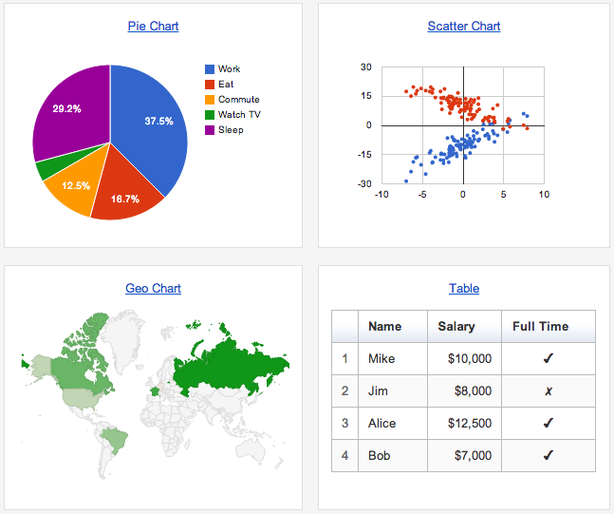
Google Graph Webpage
Create database in MariaDB
  Log in to MariaDB (mysql)
  Create new database
  Create new user and grant necessary privileges
  Flush (refresh) privileges
  Create new table in database
  Import data
Create website
  Create new subfolder for temperature data
  Download necessary webpage files to new location
  Validate any necessary settings
Test!

Slide 31

Virtual Host Configurations
Download SQL data (that’s a capital O!)
  cd /tmp; curl -O https://jpatalon.cs.edinboro.edu/ecsc325/classfiles/temperature_data.sql
Create new database, user, and import SQL data
  mysql -u root –p
  create database temperature;
  grant all privileges on temperature.* to 'temperature'@'localhost' identified by "temperaturepass";
  CREATE TABLE IF NOT EXISTS temperature.temp (ID MEDIUMINT NOT NULL AUTO_INCREMENT, Date DATE, Time TIME, Temperature FLOAT, Humidity FLOAT, Dewpoint FLOAT, PRIMARY KEY (ID)) ENGINE=InnoDB;
  LOAD DATA LOCAL INFILE '/tmp/temperature_data.sql' INTO TABLE temperature.temp;
  flush privileges;
  exit;
Notes:
Google graph website

Slide 32
Virtual Host Configurations
We need a new 1##.megastuff.biz virtual host definition!
  #File /etc/httpd/conf.d/1##.megastuff.conf
  <VirtualHost *:80>
  ServerName 1##.megastuff.biz
  DocumentRoot "/var/www/1##"
  </VirtualHost>
Dont forget to restart Apache!
  systemctl restart httpd
Replace the ## with your 2 digit number!!!

Slide 33
Virtual Host Configurations
Create new megastuff temperature directory and download necessary web pages
    mkdir -p /var/www/1##/temp/
    cd /var/www/1##/temp/
    wget https://jpatalon.cs.edinboro.edu/ecsc325/classfiles/jquery.min.js
    wget https://jpatalon.cs.edinboro.edu/ecsc325/classfiles/loader.js
    wget https://jpatalon.cs.edinboro.edu/ecsc325/classfiles/temp.php
    wget https://jpatalon.cs.edinboro.edu/ecsc325/classfiles/getData
    mv getData getData.php
Check
  http://1##.megastuff.biz/temp/temp.php
Page not loading?
  Check the log files…
      /var/log/httpd
  Check the permissions!
Replace the ## with your 2 digit number!!!
Notes:
Google graph website

Slide 34
Virtual Hosts
http://ecsc325-1##.cs.edinboro.edu, http://147.64.243.1##
  index.html: Hello ECSC-325 (Assignment 6)
  index.php: PHP Info (Assignment 7)
http://ecsc325-1##.cs.edinboro.edu/phpmyadmin, http://147.64.243.1##/phpmyadmin
  phyMyAdmin Website
http://1##.megastuff.biz/temp/temp.php
  Temperature Graph Website
http://31##.megastuff.biz
  index.html: Hello Megastuff Website
http://1##.ultrastuff.net
  Ultra Modern Template Website
http://31##.ultrastuff.net
  WordPress Website
http://##.megastuff.biz
  TBD: Test page…
http://1##.megastuff.biz
  TBD: Test page…
http://ecsc325-1##.cs.edinboro.edu/squirrelmail
  TBD: Squirrelmail webmail
http://roundcube.##.megastuff.biz
  TBD: Roundcube webmail
https://ecsc325-1##.cs.edinboro.edu/private
  TBD: Private web site!
https://a13.##.megastuff.biz
  TBD: Assignment 13 web site!
Replace the ## with your 2 digit number!!!

Slide 35

Configure
Install PHP and change default index file
  phpinfo!
Install & Configure MariaDB
Localhost config file
31## megastuff config file
31##p81 megastuff config file
Virtual hosts
  Ecsc325-1##, 31##.megastuff.biz, 31##.megastuff.biz:81
Update your system
Reboot
Assignment 7

Slide 36
Configure
Ultra Modern Website
Wordpress Website
EPEL Install
phpMyAdmin Install
Temperature graph website
Virtual hosts
  Ecsc325-1##, phpMyAdmin,
  temperature graphs, Megastuff,
  Ultrastuff, Wordpress…
Update your system
Reboot
Assignment 8

Slide 37
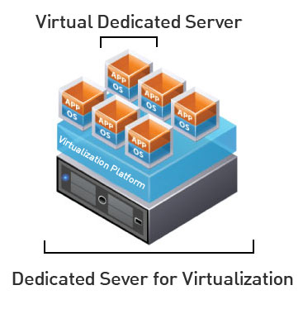
Virtual Machine Info
IP Address: 147.64.243.1## (01-25)
Hostname: ecsc325-1##.cs.edinboro.edu (01-25)
Alias: ##.megastuff.biz (01-25)
  1##.megastuff.biz, 31##.megastuff.biz, 1##.ultrastuff.net, others?
Assignment 5 due tomorrow night, Assignment 6 & 7 next week!
  Check script submissions and document uploads in D2L!
Accessing VM’s from off campus requires a connection to the CS VPN first,
before opening a connection to your machine!
  CS firewall prevents direct connections from other networks to our VM’s!
    Once VPN is active: ssh user@ecsc325-1##.cs.edinboro.edu
math.cs.cdinboro.edu replaced with cs.edinboro.edu!
megastuff.online replaced with megastuff.biz!

Slide 38
ECSC 325.200
Web Server Administration
Spring 2025 – Week 6-2 – February 20th, 2025
Web Server Installations & Configurations
Prof. Jason Patalon

Slide 39

Objectives
IP Address Review
SSH Tunnels Review
Web Server Review
Ports
E-Mail Services
  History of E-Mail
  Understanding the E-Mail environment
  E-Mail protocols
    SMTP
    IMAP
    POP
  E-Mail services installation
    Configuration
    Caveats
  Web-Mail Installation
    Squirrelmail
    Roundcube
Next
Week?!

Slide 40
Recap and Review
The next few weeks…
  File transfer services
  Security and authentication
  Network Services
  Monitoring and performance tuning
Review of previous assignments
Questions from previous classes?
Assignment 6 due next week!
Assignment 7 due next week!
Etcetera…

Slide 41
Remaining Semester Topics*
E-Mail Services
  SMTP
  POP
  Postfix
  Dovecot
  SquirrelMail
  Roundcube
File Transfer Services
  FTP
  SCP
  RSync
Network Functions
Security
  HTTP Authentication
  HTTPS/SSL
  Firewall
  SELinux
  Public Key Cryptography
Monitoring
Backups
Performance Tuning
Final Exam
* Exact topics may change
Clouds?!

Slide 42
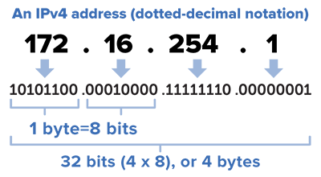
Finding IP address ranges
Consider the following CIDR mask: 147.64.242.128/23
  Convert the IP address to binary
    10010011.01000000.11110010.10000000
  Convert netmask to binary
    /23 = 255.255.254.0 = 11111111.11111111.11111110.00000000
  Find the opposite binary netmask (the host portion - swap 1’s and 0’s)
    11111111.11111111.11111110.00000000 → 00000000.00000000.00000001.11111111
  Do bitwise AND on the binary IP and netmask to find starting IP:
    IP Address: 10010011.01000000.11110010.10000000
    Netmask: 11111111.11111111.11111110.00000000
    Starting IP: 10010011.01000000.11110010.00000000
  Convert new binary number to decimal
    10010011.01000000.11110010.00000000 = 147.64.242.0
      This is our starting IP address for the range!
The first IP in the range is reserved for the “Network ID”

Slide 43
Finding IP address ranges
Consider the following CIDR mask: 147.64.242.128/23
  Convert the IP address to binary
    10010011.01000000.11110010.10000000
  Convert netmask to binary
    /23 = 255.255.254.0 = 11111111.11111111.11111110.00000000
  Find the opposite binary netmask (the host portion - swap 1’s and 0’s)
    11111111.11111111.11111110.00000000 → 00000000.00000000.00000001.11111111
  Do bitwise OR on the binary IP and opposite mask to find ending IP:
    IP Address: 10010011.01000000.11110010.10000000
    Netmask: 00000000.00000000.00000001.11111111
    Ending IP: 10010011.01000000.11110011.11111111
  Convert new binary number to decimal
    10010011.01000000.11110010.00000000 = 147.64.243.255
      This is our ending IP address for the range!
        Put them together, we have 147.64.242.0 - 147.64.243.255
The last IP in the range is reserved for the “Broadcast address”

Slide 44

Broadcast Address
A network address which will broadcast packets to all hosts connected to that network
  “The all-ones host”
  The last IP address in an IP address range
    EUP CS Department: 147.64.243.255/23
  Only used by IPv4
    IPv6 uses a “all-hosts multicast group” to accomplish similar functionality more efficiently
  Data sent to a broadcast address isn’t routed
    This keeps the broadcast packet within the local network
  Necessary for DHCP
    Often sent to IP address 255.255.255.255
    Helper addresses used if DHCP server in a different subnet
  Layer 2 broadcasts to MAC address FF:FF:FF:FF:FF:FF
Default Gateway
  Next hop in transmitting my traffic be default

Slide 45

Understanding HTTP
As an example, in a web browser you type:
http://jpatalon.ultrastuff.net
  Web browser contacts DNS server to resolve IP address
    That was a multi-step process…
  DNS server returns IP address to browser
  Web browser composes a request using IP address to port 80
    Request will include host name
    Web Browser assumes port 80 if no port is specified
    Web server is configured to return index page if no page is specified
    Web server may return directory listing if no index.html is found
  GET / HTTP/1.1
  Host: jpatalon.ultrastuff.net

Slide 46
Understanding HTTP
We can manually connect to a website and download webpages with telnet or a similar application
  Telnet application would need installed on our VM’s
    dnf provides */telnet
    dnf install telnet
  Open telnet connection with following command:
    telnet hostname port
    Ex: telnet jpatalon.ultrastuff.net 80
    Watch for “Connected to” message indicating connection success
      Connected to jpatalon.ultrastuff.net.
      Escape character is '^]'.
  Download the default webpage with the following commands:
      GET / HTTP/1.1
      Host: jpatalon.ultrastuff.net

Slide 47

HTTP Services
HTTP Described in RFC’s 7230-7235
  HTTP versions 1.1 and 2.0 most widely used
  HTTP port 80 / HTTPS port 443
  Client connects to server, issues HTTP commands
    GET, HEAD, POST, etc.
    Filename to get, server hostname to use, port to use, additional details
Apache
  Apache typically runs as user apache, group apache
    The Apache user or group needs access to the files!
  Additional modules provide additional functionality
    SSL, authentication, CGI scripts, etc.
  Apache configuration files
    /etc/httpd – Main Apache directory
    /etc/httpd/conf/httpd.conf – Main Apache configuration file
    /etc/httpd/conf.d/ - Additional Apache configuration file directory

Slide 48
HTTP Example
Telnet to google.com on port 80
  Install telnet with dnf!
    dnf install telnet
    telnet www.google.com 80
Issue a get command
    GET / HTTP/1.1
    User-Agent: Mozilla/4.0 (compatible; MSIE5.01; Windows NT)
    Host: www.google.com
    Accept-Language: en-us
    Accept-Encoding: gzip, deflate
    Connection: Keep-Alive
Enter a blank line to finish the command
Default search page HTML should be returned

Slide 49
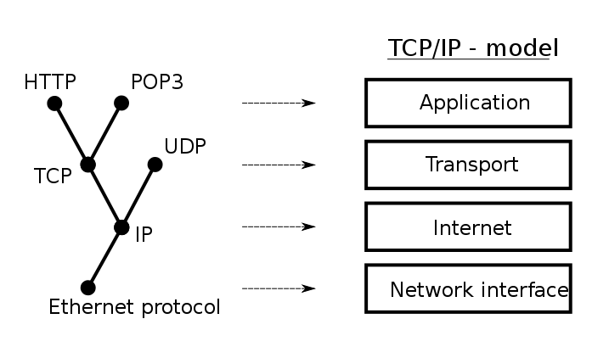
Ports
“An endpoint of communication in an operating system”
A port, combined with an IP and a protocol, creates communications session
  Generally, different source and destination IP’s and ports are necessary
əˈfem(ə)rəl
Source
  10.11.187.23 TCP port 57532
    10.11.187.23:57532
  Ephemeral port!
    A short-lived port opened by the OS when a program requests a connection to a port, released after the conversation finishes. Generally in the range 49152 to 65535 (IANA Suggestion).
    Sometimes in the range 1024-65535
    Typically only root can open a port lower than 1024
Destination
  192.168.53.79 TCP port 80
    192.168.53.79:80
    Defined service ports
Notes:
By Jsoon eu (talk) - I (Jsoon eu (talk)) created this work entirely by myself., CC BY-SA 3.0, https://en.wikipedia.org/w/index.php?curid=29962617

Slide 50
Ports
“An endpoint of communication in an operating system”
A port, combined with an IP and a protocol, creates communications session
  Generally, different source and destination IP’s and ports are necessary
session
Multiple services cannot use the same port & protocol at the same time!
  TCP and UDP ports are different, so one application can listen on TCP port 80, and another on UDP port 80.
Data is returned on the ephemeral port
  NAT will maintain this connection information, to ensure return data is sent to the appropriate internal host IP address
Point of entry to a machine and service
Notes:
By Jsoon eu (talk) - I (Jsoon eu (talk)) created this work entirely by myself., CC BY-SA 3.0, https://en.wikipedia.org/w/index.php?curid=29962617

Slide 51
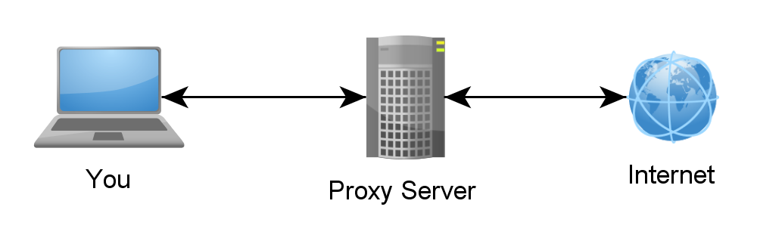
SSH Tunnels
SSH Tunnels are secure and encrypted between endpoints!
Local port forwarding
  Similar to port forwarding on a router
  ssh –L source_port:destination_host:destination_port user@host.tld
    Ex: ssh –L 5454:ecsc325-110.cs.edinboro.edu:22 jpatalon@jpatalon.cs.edinboro.edu –p 54321
    This command opens an encrypted tunnel between my local machine and ssh server jpatalon.cs.edinboro.edu
    Traffic sent to localhost port 5454 is redirected to ecsc325-110.cs.edinboro.edu port 22 through jpatalon.cs.edinboro.edu

Slide 52
SSH Tunnels
SOCKS (Dynamic) Proxy
  Allows for website proxying
  Can be used to allow connections around firewalls
    Connect to your ecsc325 web server from anywhere through an intermediate host
  ssh –D port user@host.tld
    Ex: ssh –D 55555 jpatalon@jpatalon.cs.edinboro.edu –p 54321
    This command opens an encrypted tunnel between my local machine and ssh server jpatalon.cs.edinboro.edu
    Web SOCKS traffic is sent through port 5555 to server jpatalon.cs.edinboro.edu, where it is then forwarded to the destination

Slide 53
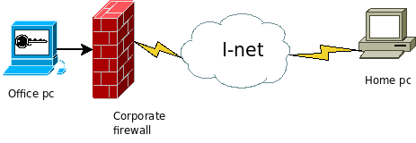
SSH Tunnels
Reverse SSH Tunnel
  Initiate a connection from within a network to a remote location, allowing reverse traffic
Notes:
Reverse SSH images from toic.org

Slide 54
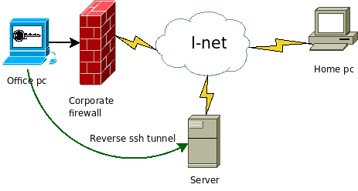
SSH Tunnels
Reverse SSH Tunnel
  Initiate a connection from within a network to a remote location, allowing reverse traffic
  Reverse SSH tunnel opened from office PC to outside server
Notes:
Reverse SSH images from toic.org

Slide 55
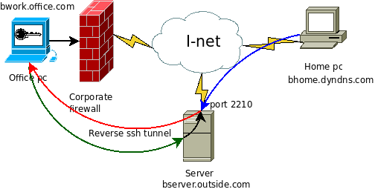
SSH Tunnels
Reverse SSH Tunnel
  Initiate a connection from within a network to a remote location, allowing reverse traffic
  Reverse SSH tunnel opened from office PC to outside server
  Outside server now has encrypted path inside corporate firewall
Notes:
Reverse SSH images from toic.org

Slide 56
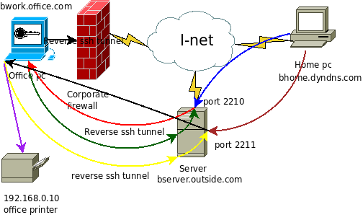
SSH Tunnels
Reverse SSH Tunnel
  Initiate a connection from within a network to a remote location, allowing reverse traffic
  Reverse SSH tunnel opened from office PC to outside server
  Outside server now has encrypted path inside corporate firewall
  Traffic can now be routed through the office pc to the internal network, bypassing firewall and security measures
  Server bserver.outside.com is hiding true source of bhome.dyndns.com
Many corporate firewalls block outbound traffic for this reason!
Notes:
Reverse SSH images from toic.org

Slide 57

History of E-Mail
Various host-based email systems were set up to share files among users
  Most only allowed for sharing of files among users on the same server
  Many different systems with different features, often incompatible
LAN email systems developed to handle PC’s
  Initially only allowed communication between users on the same server
  Eventually allowed different servers to communicate, so long as they all used the same email system and proprietary protocol
Many different attempts at email network standards
SMTP became standard in mid 1990’s
  Created standards for email addressing, formatting, and transmissions

Slide 58
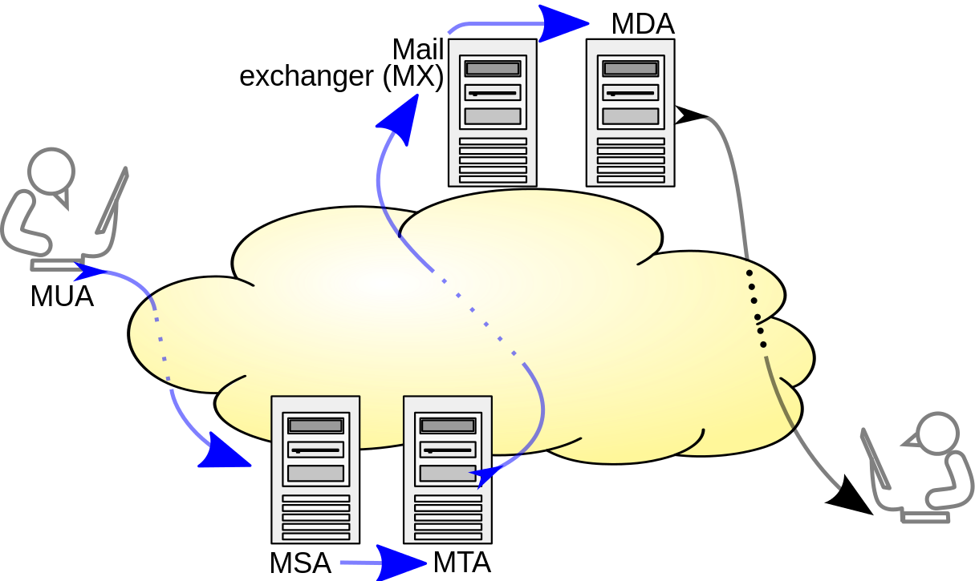
E-Mail System Terminology
MSA – Mail Submission Agent
  Provides address resolution services
  Determines appropriate server to send email to for specified email address
  Looks up MX records for a domain
MTA – Mail Transfer Agent
  Accepts E-Mail from clients and sends to another MTA for delivery
  Indicated by MX DNS records
  Sendmail, Postfix
MDA – Mail Delivery Agent
  Delivers E-Mail from server to MUA (inbox)
  Integrated with Sendmail, Postfix
MUA – Mail User Agent
  E-Mail client
  Outlook, pine, Gmail, SquirrelMail
Multiple functions
can be combined!
Notes:
By Ale2006-from-en - Own work, CC BY-SA 3.0, https://commons.wikimedia.org/w/index.php?curid=10583999
Blue arrows indicate SMTP

Slide 59
E-Mail System Terminology
Open E-Mail Relay
  Allows for sending of E-Mail to an intermediate mail server, before the message is sent to its destination
  May allow for anyone to send email as anyone to anyone else
  Open relay’s will accept email for any domain and attempt to deliver
  Should not be allowed on the Internet, can easily be abused for spamming
  Typical E-Mail relay only allows authorized clients to connect
Masquerading
  Replacing your actual host name with the email domain name
  Ex: instead of smtp.gmail.com, just gmail.com
Spammers
  Jerks who send unsolicited E-Mail to sell something or trick users

Slide 60
DNS for E-Mail
In order to send email to a user, the domain for that user needs an MX record
  The MX record indicates which server is responsible for accepting email for a domain
  MX records can be found using the “dig mx domainname.tld” command
  The MX record itself also needs an A/AAAA record to resolve the IP address for the mail server
  The MX record is proceeded by an integer indicating server priority
    Delivery is attempted to servers with a lower priority number first, following servers attempted in sequence
Multiple servers can service a single domain name
  Multiple MX records for a domain provides fault tolerance
A single mail server can service multiple domain names
  A mail server may handle email for multiple domains

Slide 61
DNS for E-Mail
Example E-Mail DNS Records
First MX record indicates mail server spamblock.edinboro.edu
  Priority is 5
  IP address (A record) is 147.64.32.99
Second MX record indicates mail server spamblock2.edinboro.edu
  Priority is 10
  IP address (A record) is 147.64.32.98
edinboro.edu. 3600 IN MX 5 spamblock.edinboro.edu.
edinboro.edu. 3600 IN MX 10 spamblock2.edinboro.edu.
spamblock.edinboro.edu. 3600 IN A 147.64.32.99
spamblock2.edinboro.edu. 7200 IN A 147.64.32.98

Slide 62
E-Mail Protocols
Simple Mail Transfer Protocol (SMTP)
  Used to send E-Mail messages
    From user to mail server, or between mail transfer agents
Post Office Protocol 3 (POP3)
  Used to retrieve E-Mail from a server
  Traditionally all messages are downloaded to the client and removed from the server
    New POP3 implementations will allow downloaded messages to remain on server
Internet Message Access Protocol (IMAP4)
  Used to retrieve E-Mail from a server
  E-Mail messages will remain on server
  Server can be configured with folders for organization

Slide 63
E-Mail Ports
Simple Mail Transfer Protocol (SMTP)
  Port 25: Legacy SMTP relaying port, currently mostly used for SMTP relaying between servers. Often blocked by ISP’s to prevent spam.
  Port 465: Deprecated secure SMTP submission port, should no longer be used.
  Port 587: Current formalized SMTP submission port. Can be used with encryption.
  Additional ports are often used.
Post Office Protocol 3 (POP3)
  Port 110: Default non-encrypted port
  Port 995: Encrypted POP3 port
Internet Message Access Protocol (IMAP4)
  Port 143: Default non-encrypted port
  Port 993: Encrypted IMAP port

Slide 64
SMTP Commands and processes
Commands are processed by the SMTP server
E-Mail can be manually sent using some of the commands below
Command | Purpose
HELO | Identifies the domain sending the message
DATA | Indicates the body of the message
VRFY | Verifies the e-mail user
QUIT | Ends the SMTP session

Slide 65
SMTP Commands and processes
SMTP headers can be used to add descriptive information
Header | Description
MAIL FROM: | Identifies who is sending the message (required)
RCPT TO: | Identifies the recipient of the message (required)
RECEIVED: | Identifies the e-mail server that processed the message
DATE: | Indicates the date of the e-mail
FROM: | Shows the e-mail address as it is typically displayed in an e-mail client
SUBJECT: | Shows the subject of the e-mail message
TO: | Shows the recipient as it is typically displayed in an e-mail client
CC: | Sends copies of the message to a list of e-mail addresses
BCC: | Sends copies of the message to a list of e-mail addresses but does not display the e-mail addresses

Slide 66
SMTP Commands and processes
Sample SMTP Session (edinboro.edu):
[root@ecsc325-125 ~]$ telnet spamblock.edinboro.edu 25
Trying 147.64.32.99...
Connected to spamblock.edinboro.edu.
Escape character is '^]'.
220 barracuda.edinboro.edu ESMTP (8908a72cdf255605894d2e1a03ee284e)
HELO megastuff.biz
250 barracuda.edinboro.edu Hello ecsc325-125.cs.edinboro.edu [147.64.243.125], pleased to meet you
MAIL FROM: <jason@megastuff.biz>
250 Sender <jason@megastuff.biz> OK
RCPT TO: <jpatalon@edinboro.edu>
250 Recipient <jpatalon@edinboro.edu> OK
DATA
354 Start mail input; end with <CRLF>.<CRLF>
From: jason@megastuff.biz
To: jpatalon@edinboro.edu
Subject: test email
This is a test
.
250 Ok: queued as EFB4511EE001
quit
221 barracuda.edinboro.edu Goodbye ecsc325-125.cs.edinboro.edu, closing connection

Slide 67
SMTP Commands and processes
Sample SMTP Session (pennwest.edu):
[root@csci325-110 ~]# telnet pennwest-edu.mail.protection.outlook.com 25
Trying 52.101.41.6...
Connected to pennwest-edu.mail.protection.outlook.com.
Escape character is '^]'.
220 SJ1PEPF00001CE6.mail.protection.outlook.com Microsoft ESMTP MAIL Service ready at Sun, 16 Feb 2025 21:05:06 HELO megastuff.biz
250 SJ1PEPF00001CE6.mail.protection.outlook.com Hello [147.64.2.12]
MAIL FROM: <elon@megastuff.biz>
250 2.1.0 Sender OK
RCPT TO: <jpatalon@pennwest.edu>
250 2.1.5 Recipient OK
DATA
354 Start mail input; end with <CRLF>.<CRLF>
From: "President Elon Reeve Musk, Esq." <elon@tesla.gov>
To: <jpatalon@pennwest.edu>
Subject: test email
This is an Elon test for ecsc325...
.
250 2.6.0 <…> […] 8978 bytes in 2.971, 2.951 KB/sec Queued mail for delivery
quit
221 2.0.0 Service closing transmission channel

Slide 68
SMTP Commands and processes
Most SMTP servers will only accept E-Mail to or from users of that server
SMTP servers will often check the SPF record of the sender before accepting the message
  SPF: Sender Policy Framework
  SPF record indicates who is allowed to send email for a particular domain
  SPF record can be found with the following commands:
      dig TXT pennwest.edu
      OR
      dig SPF pennwest.edu
  Example SPF record:
    v=spf1 ip4:216.119.103.65 ~all
    Indicates SPF version, IP address(es) allowed to send email for a domain, and how to handle failure
      ~all is a soft failure, message accepted but is marked as softfail
        Useful for debugging or transitioning
      -all would be a hard fail

Slide 69
POP3 Commands and processes
Post Office Protocol 3 (POP3) is used to download user E-Mail from a server
  E-Mail messages are typically removed from the server after download
  E-Mail clients (Outlook – MUA) can be configured to leave the messages on the server
POP3 is less complicated than IMAP4
After logging in to a POP3 E-Mail server, a user can:
  List
  Read
  Download
  Delete E-Mail

Slide 70
POP3 Commands and processes
Command | Description
USER username | Connects to POP3 server based on user name
PASS password | Enters the password for the user, as in PASS: Ax6yy
LIST | Displays the message number followed by the number of characters in the message
UIDL | Displays the unique ID for each message
RETR n | Replaces the n with a message number to retrieve that message
TOP n lines | Instead of retrieving the whole message, retrieves the number of lines designated by the lines parameter for message number n
DELE n | Deletes message number n from the server
QUIT | Ends the session

Slide 71
POP3 Commands and processes
Probably easier just to google it! – This specific example offline now…
Example originally from:
  http://coewww.rutgers.edu/www1/linuxclass2010/lessons/Email/sec_6.php
telnet gateway.linux.class 110
Trying 192.168.2.240...
Connected to 192.168.2.240.
Escape character is '^]'.
+OK
USER mailtest
+OK
PASS Password
+OK
RETR 1
+OK
Return-Path:
X-Original-To: mailtest@gateway.linux.class
Delivered-To: mailtest@gateway.linux.class
Received: from node18.linux.class (node18 [192.168.2.38])
by gateway.linux.class (Postfix) with ESMTP id A291B2B15C
for ; Tue, 12 Apr 2005 22:24:53 -0400 (EDT)
Received: from me?here.com (unknown [192.168.2.250])
by node18.linux.class (Postfix) with SMTP id 4653B14112
for ; Tue, 12 Apr 2005 22:24:03 -0400 (EDT)
To: some_guru@somewhere.com
From: pp@pp.com
Subject: Forged e-mail
Message-Id: <20050413022403.4653B14112@node18.linux.class>
Date: Tue, 12 Apr 2005 22:24:03 -0400 (EDT)
Hey,
The "To:" and "From:" are non-existent, but you still get the e-mail.
bye, bye
.
DELE 1
+OK
QUIT

Slide 72
IMAP4 Commands and processes
Using IMAP4, E-Mail messages will remain on server
Requires more storage space on the server (most costly for server owners/operators)
Messages are flagged to keep track of status. Flags include:
  \Recent
  \Seen
  \Answered
  \Flagged
  \Deleted
  \Draft
Led to the Microsoft developing Messaging API (MAPI)
  Used for Microsoft Exchange
    Provides many functions similar to IMAP
  Can be used for things besides email

Slide 73
IMAP4 Commands and processes
Command | Description
LOGIN username password | Log on to the server with your user name and password, which are unencrypted.
SELECT mailbox | Select a mailbox before you perform mail tasks. The default mailbox is called inbox. The response gives a summary of mailbox information.
FETCH message(s) item(s) | Retrieve messages. The message(s) parameter gives the message number. The item(s) parameter determines what part of the message is fetched—that is, individual header items or the body of the text.
STORE message(s) flags | Change the flags associated with a message. Typically, this command is used to mark messages to be deleted, undeleted, or identified as unread.
LOGOUT | End the IMAP4 session.

Slide 74
E-Mail Client Configuration
A typical E-Mail client will need the following configuration information:
  SMTP server hostname or IP address for sending mail
    Ex: smtp.hostname.com
  POP3 or IMAP4 server hostname or IP address for retrieving mail
    Ex: pop3.hostname.com
  A valid E-Mail address account name
  A valid password

Slide 75
Web-based E-Mail Clients
Web-based E-Mail clients allow users to send email directly from their web browser
SquirrelMail & Roundcube are web-based email services which can be freely installed on a mail server
Most current public E-Mail services use some kind of web-based email
  Ex: Gmail, Yahoo mail, outlook.com
MS Exchange server can be used with Outlook Web Access (OWA)
Web-based email clients offer many benefits over traditional E-Mail clients:
  No client configuration necessary, reducing user configuration support
  No specialized software necessary to purchase, install, or maintain on clients
  Users can retrieve E-Mail from any computer that can access the website
  Additional features can be integrated, beyond standard POP3 or IMAP features

Slide 76
Virtual Hosts
http://ecsc325-1##.cs.edinboro.edu, http://147.64.243.1##
  index.html: Hello ECSC-325 (Assignment 6)
  index.php: PHP Info (Assignment 7)
http://ecsc325-1##.cs.edinboro.edu/phpmyadmin, http://147.64.243.1##/phpmyadmin
  phyMyAdmin Website
http://1##.megastuff.biz/temp/temp.php
  Temperature Graph Website
http://31##.megastuff.biz
  index.html: Hello Megastuff Website
http://1##.ultrastuff.net
  Ultra Modern Template Website
http://31##.ultrastuff.net
  WordPress Website
http://##.megastuff.biz
  TBD: Test page…
http://1##.megastuff.biz
  TBD: Test page…
http://ecsc325-1##.cs.edinboro.edu/squirrelmail
  TBD: Squirrelmail webmail
http://roundcube.##.megastuff.biz
  TBD: Roundcube webmail
https://ecsc325-1##.cs.edinboro.edu/private
  TBD: Private web site!
https://a13.##.megastuff.biz
  TBD: Assignment 13 web site!
Replace the ## with your 2 digit number!!!

Slide 77
Virtual Machine Info
IP Address: 147.64.243.1##/23 (01-25)
Hostname: ecsc325-1##.cs.edinboro.edu (01-25)
Aliases:
  31##.megastuff.biz, 1##.megastuff.biz, ##.megastuff.biz (01-25)
  1##.ultrastuff.net, more?
Assignments 6 & 7 due next week!
  Both available now!
  Check script and document upload in D2L!
Accessing VM’s from off campus requires a connection to the CS VPN first,
before opening a connection to your machine!
  CS firewall prevents direct connections from other networks to our VM’s!
    Once VPN is active: ssh user@ecsc325-1##.cs.edinboro.edu

Slide 78
Linux Commands
systemctl
systemctl list-unit-files
dig
nslookup
ssh
mkdir
wget
cd
ls
mv
pwd
vi
nano
dnf
mysql
chown
chmod
rm
rpm
telnet

Slide 79

Key Terms and Items
SSH tunnel
Reverse SSH tunnel
HTTP
Apache
Ports
E-Mail
MTA
MSA
MUA
MUA
Open E-Mail relay
Masquerading
Spammers
MX records
SMTP
POP3
IMAP4
RFC

Slide 80

For Next Week
“Many of life’s failures are men who did not realize how close they were to success when they gave up”
  Thomas Edison
Textbook:
  Chapter 16 – DNS
  Chapter 18 – Apache
  Chapter 19 – SMTP
  Chapter 20 – POP/IMAP
Next week topics
  E-Mail Services, File Transfers
Continuing work with VM’s
  Assignment 5 was due this week!
  Assignment 6 & 7 due next week.
  Assignment 8 available? - due in 2 weeks?
  Just because all tests say OK, doesn’t mean everything is working properly!

